Slide 1

ECB1204 – ANALOG INTEGRATED CIRCUIT DESIGN MODULE 1 - IMPLEMENTATION OF RAINFALL DETECTOR ALARM USING IC 555 TIMER
Presented by:
KABILESH SUDHAN S A (2303811710621045)
JAYA SURIYA K (2303811710621041)
DHIVAHARAN L (2303811710621022)
Under the Guidance of
PARTHIPARAJ
ASSISTANT PROFESSOR
ECE

Slide 2
OUTLINE
ABSTRACT –MODULE 1
INTRODUCTION
BLOCK DIAGRAM
HARDWARE REQUIREMENT
ADVANTAGES AND APPLICATIONS
CONCLUSION
PROJECT PLAN
REFERENCES

Slide 3
MODULE 1
IMPLEMENTATION OF RAINFALL DETECTOR ALARM USING IC 555 TIMER

Slide 4
ABSTRACT - MODULE 1
The implementation of a rainfall detector alarm using the IC 555 timer is a practical and efficient system designed to detect rain and alert users through an audible or visual alarm.
This system uses water-sensitive sensors to detect rainfall, triggering the IC 555 timer configured in monostable or astable mode to activate an output alarm such as a buzzer or LED.
The circuit ensures timely alerts for applications like protecting outdoor equipment, monitoring agricultural conditions, or signaling during unexpected rain. Its simplicity, cost-effectiveness, and reliability make it an ideal choice for small-scale weather detection projects.

Slide 5
INTRODUCTION – MODULE 1
A rainfall detector alarm is a simple and effective system designed to detect the presence of rain and provide an immediate alert through an alarm mechanism. This system is particularly useful in protecting outdoor assets, automating irrigation systems, and aiding weather monitoring efforts.
By employing the versatile IC 555 timer, the circuit achieves reliable performance with minimal components, making it both cost-effective and easy to implement. The 555 timer, configured in either monostable or astable mode, serves as the core of the alarm, while a water-sensitive sensor ensures accurate rainfall detection. This project combines basic electronic principles with practical applications to create a functional and user-friendly device.

Slide 6
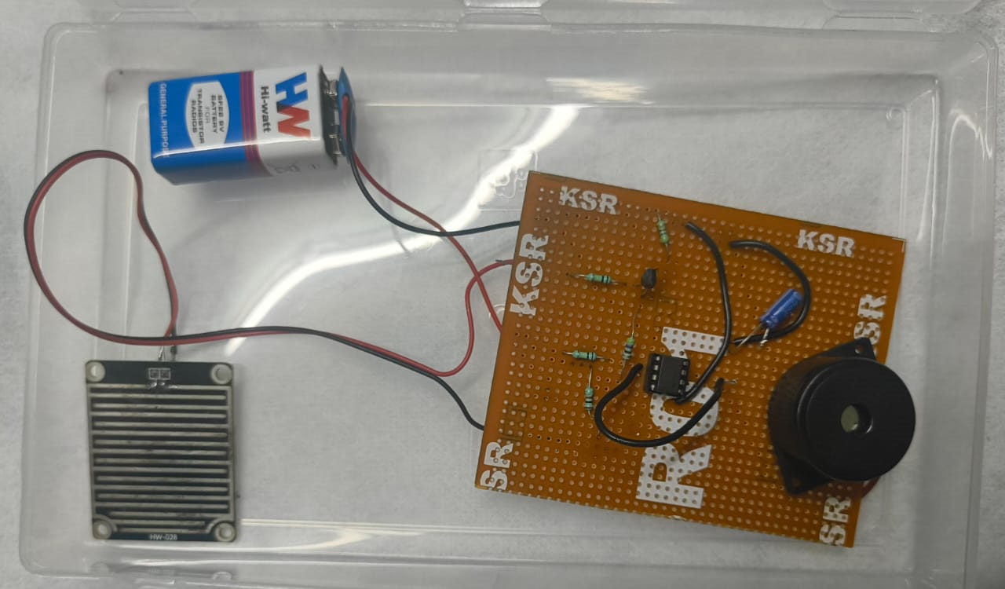
CIRCUIT DIAGRAM

Slide 7
HARDWARE MODULE
IC 555
RESISTOR
CAPACITOR
BATTERY
PCB BOARD
BUZZER
RAIN SENSOR

Slide 8
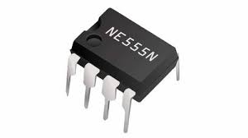
IC 555
The IC 555 timer is a widely used integrated circuit in electronics due to its versatility, simplicity, and low cost. It is capable of generating precise timing, oscillation, and pulse-width modulation, making it a staple in many applications like timers, pulse generators, waveform generators, and control circuits.

Slide 9
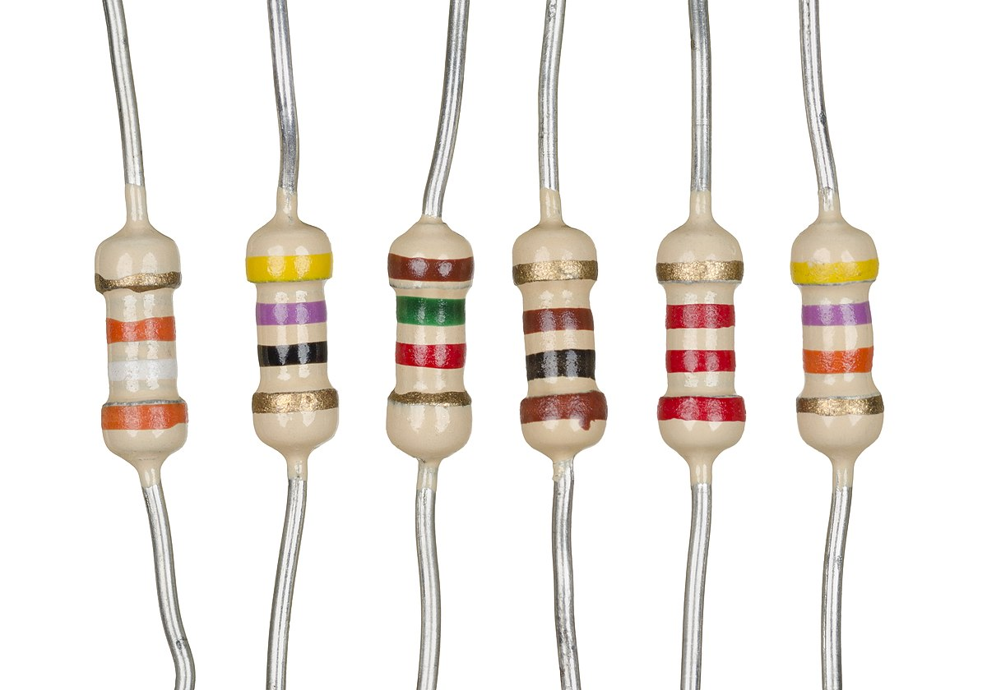
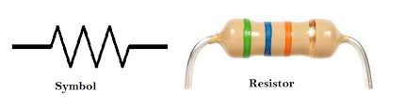
RESISTOR
Resistors are critical components in the rainfall detector alarm circuit as they control current flow and set timing intervals for the IC 555 timer. In this project, resistors are used to determine the charging and discharging times of the capacitor connected to the 555 timer, which influences the duration and frequency of the alarm signal. Fixed resistors ensure stable operation by providing consistent resistance values, while variable resistors (if used) allow for fine-tuning the sensitivity or timing of the circuit. The choice of resistor values is crucial to ensure the circuit operates within the desired parameters and avoids overheating or overloading other components.

Slide 10
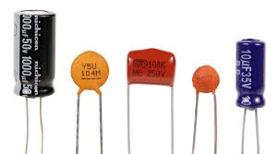
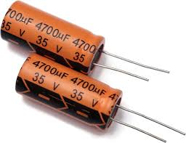
CAPACITOR
Capacitors play a vital role in the rainfall detector alarm circuit by storing and releasing electrical energy, which influences the timing and stability of the IC 555 timer's operation. In this project, capacitors are used to work alongside resistors to determine the timing intervals in monostable or astable configurations, controlling the duration of the alarm signal. Additionally, capacitors help filter noise and stabilize the power supply, ensuring consistent performance of the circuit. The selection of appropriate capacitance values is crucial for achieving the desired timing and reliable detection response, making capacitors indispensable components in this design.

Slide 11
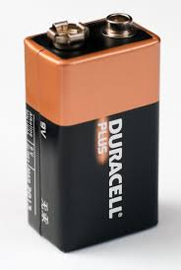
POWER SUPPLY
The power supply in the rainfall detector alarm circuit provides the necessary electrical energy to operate all components, including the IC 555 timer, sensor, and alarm. A stable DC power source, typically ranging from 5V to 12V, is used to ensure reliable performance. Batteries or regulated DC adapters are commonly employed to prevent fluctuations that could disrupt the circuit's operation. The power supply also needs to be adequately filtered, often with capacitors, to minimize noise and maintain consistent voltage levels. Proper voltage selection and regulation are critical to prevent damage to the components and ensure the efficient functioning of the system.

Slide 12
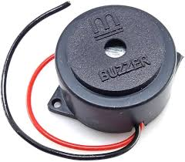
BUZZER
A buzzer is a compact audio signaling device that converts electrical energy into sound, commonly used for alerts or notifications in electronic systems. It comes in two types: active buzzers, which produce sound when powered by DC voltage due to an internal oscillator, and passive buzzers, which require an external signal or oscillator to generate sound. Buzzers are known for their reliability, low power consumption, and ease of use, making them ideal for applications such as alarms, rainfall detectors, security systems, timers, and electronic appliances where auditory feedback is essential.

Slide 13
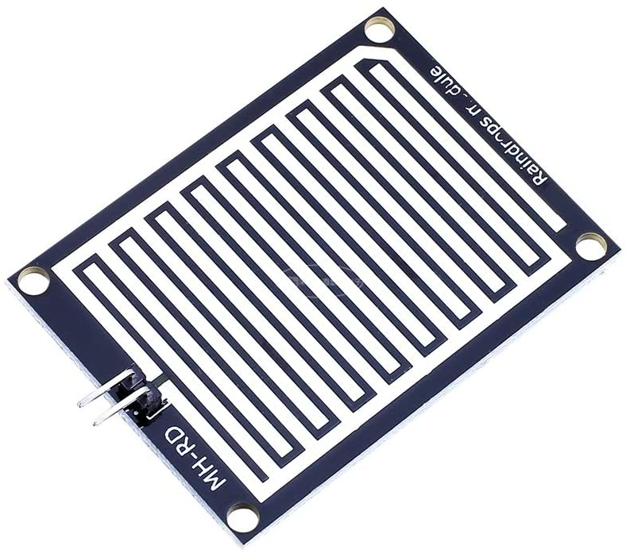
RAIN SENSOR
The rain sensor is a key component of the rainfall detector alarm, designed to detect the presence of water and trigger the circuit. Typically, it consists of a conductive surface or a set of interdigitated traces that act as electrodes. When rainwater falls on the sensor, it bridges the gaps between the traces, creating a conductive path that changes the electrical signal. This signal is fed into the IC 555 timer, which processes it to activate the alarm. The sensor is usually made of corrosion-resistant materials to ensure durability and accurate performance in outdoor conditions. Its sensitivity can be adjusted by varying the connected resistor values, making it adaptable to different rainfall detection requirements.

Slide 14
ADVANTAGES AND APPLICATIONS
Advantages:
Simple and cost-effective design with minimal components.
Provides quick and reliable rain detection for timely alerts.
Low power consumption, suitable for battery-powered setups.
Durable and customizable for various sensitivity levels and environments.
Applications:
Protection of outdoor equipment or clothes during unexpected rain.
Automation of irrigation systems in agriculture.
Assisting weather monitoring in homes or small industries.
Alert systems for rain-sensitive outdoor activities or installations.

Slide 15
CONCLUSION
The rainfall detector alarm using an IC 555 timer is a simple, efficient, and cost-effective solution for detecting rain and providing timely alerts. By leveraging the 555 timer's versatility and incorporating a water-sensitive sensor, the system ensures reliable operation across various applications such as weather monitoring, irrigation automation, and asset protection.
Its ease of assembly, low power consumption, and adaptability make it an ideal choice for both beginners and professionals in electronics. This project demonstrates the practical implementation of basic electronic components to create a functional device with real-world utility.

Slide 16
PROJECT PLAN
Design and Component Selection: Define the circuit configuration (monostable or astable) for the IC 555 timer and select components such as resistors, capacitors, a rain sensor, and a suitable power supply. Create a circuit diagram for reference.
Circuit Assembly and Testing: Assemble the circuit on a breadboard or PCB, connecting the rain sensor, IC 555 timer, and output alarm. Test the functionality by simulating rain detection to verify sensor response and alarm activation. Adjust resistor or capacitor values if needed for optimal performance.
Final Integration and Deployment: Secure the components in a protective enclosure to shield the circuit from environmental factors. Install the rain sensor in an appropriate outdoor location and connect the power supply. Conduct final tests in real-world conditions to ensure reliability before full deployment.

Slide 17
REFERENCES
Practical Electronics for Inventors" by Paul Scherz and Simon Monk – Comprehensive coverage of electronic components and circuits, including IC 555 applications.
NE555 Timer IC Datasheet – Detailed technical specifications and example circuits for the IC 555 timer.
Websites like Electronics Hub or Circuit Digest offer tutorials and sample circuits for rainfall detectors and 555 timer applications.
IEEE Xplore – Search for related articles on simple sensor-based alarm systems using IC 555 timers.
Channels such as "GreatScott!" and "ElectroBOOM" provide engaging tutorials on electronics projects, including timer circuits and sensor-based designs.

Slide 18
THANK YOU

